Slide 1

Modeling the Magnetosphere
Samantha Sanders
Code 674
Dr. David G. Sibeck
NASA Goddard Space Flight Center

Slide 2
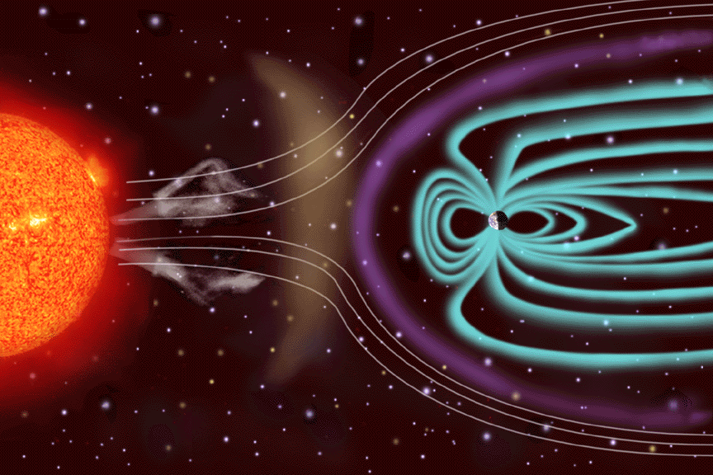
What are we modeling?
Interplanetary magnetic field (IMF)
How do the forces within it affect space weather?

Slide 3
What are we modeling?
y
EARTH
z
Velocity of solar wind
x
Many factors affect solar weather – orientation is one of them
Looking for the location of the magnetopause – the point (boundary line) between the magnetosphere and the surrounding plasma
Sun’s magnetosphere is fluid! – ripples, waves, bounces, moves

Slide 4
The CCMC
Provides web-based space weather models for researches to use – ultimate goal to help predict space weather
solar, heliospheric, magnetospheric, and ionospheric models with automated requests
produces a visualization
- Sample inputs for magnetospheric models

Slide 5
Magnetospheric Models - Variations
BATS-R-US (Block-Adaptive-Tree-Solarwind-Roe-Upwind-Scheme)
SWMF/BATS-R-US with RCM (Space Weather ModelinG Framework/BATSRUS with Rice Convection Model)
LFM-MIX (Lyon-Fedder-Mobarry model)
Goal – understand discrepancies between the models to improve prediction accuracy and efficiency

Slide 6
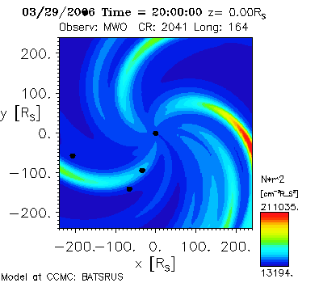
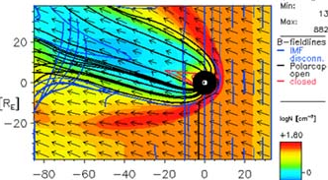
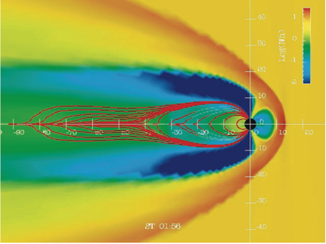
Magnetospheric Models – Sample Visualizations
SWMF separate visual
BATS-R-US visual
LFM visual

Slide 7
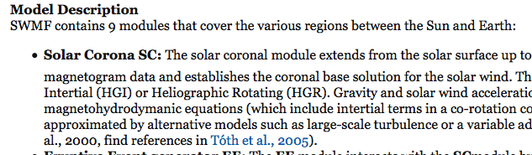
Using the Models
* The various models are based on different computational modules
Example, SWMF/BATS-R-US model

Slide 8
Prediction Dilemmas
Discrepancies in calculating the magnetopause locations between the models – could lead to errors in accurately predicting space weather
Model comparison – submitting multiple runs of sample data

Slide 9
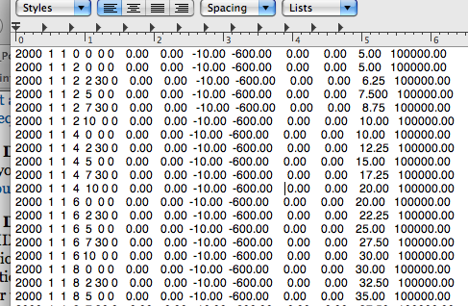
The Submissions
Generate input data
LOTS of input data
two different comparisons – one varying solar wind velocity, one adjustingthe magnetic field
watch out for – keeping IMF values constant, increase pressure and density of field
watch for each model’s variations in predicting magnetopause location based on magnetosphere’s behavior

Slide 10
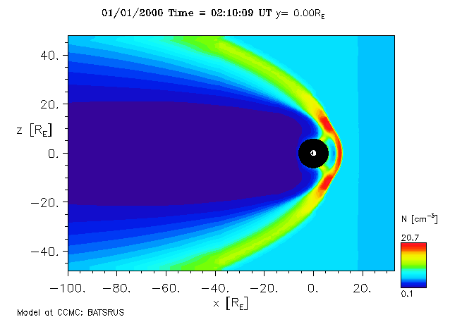
Analyzing the Results - Models

Slide 11
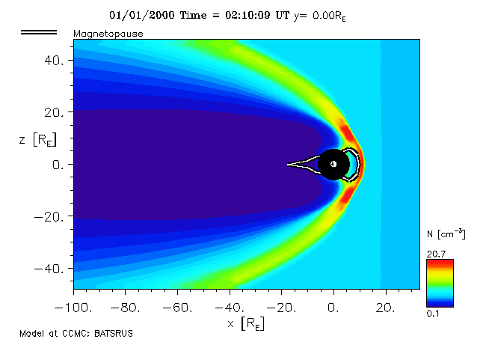
Analyzing the Results - Models

Slide 12
Analyzing the Results - Comparison
Compare model results to each other – points on a simple graph
Use a line of actual observed data from a typical set
Calculated distance of model points from observed points gives margin of error for each model

Slide 13
Analyzing the Results - Future
Work still to be done!
Need more run data to complete – a small amount of results won’t create a good line to compare with the database of observed features
Problems can occur with submissions

Slide 14
Acknowledgements
Dr. David Gary Sibeck
Dr. Masha Kuznetsova
The Dayside Science crew
Uthra Rao and Mitch Wynyk
Diane Cockrell
Cori Quirk and the SESI Program

